Slide 1
Listening and integrated skills A2
Instructor: Nguyen Ha Phuong

Slide 2
Unit 9: Our relationship with nature
Pages 161-180

Slide 3
Lesson objectives
By the end of the lesson, students will be able to:
identify the harmful effects of human behavior in a report about penguin colonies.
analyze different points of view in a conversation about the relationship between people and animals in Kariba Town in Zimbabwe.
use collocations.
recognize cause and effect.
recognize reduced words.
analyze arguments.

Slide 4
TABLE OF CONTENTS
01
02
03
04
05
VOCABULARY A
LISTENING A
VIDEO WATCHING
VOCABULARY B
LISTENING B

Slide 5
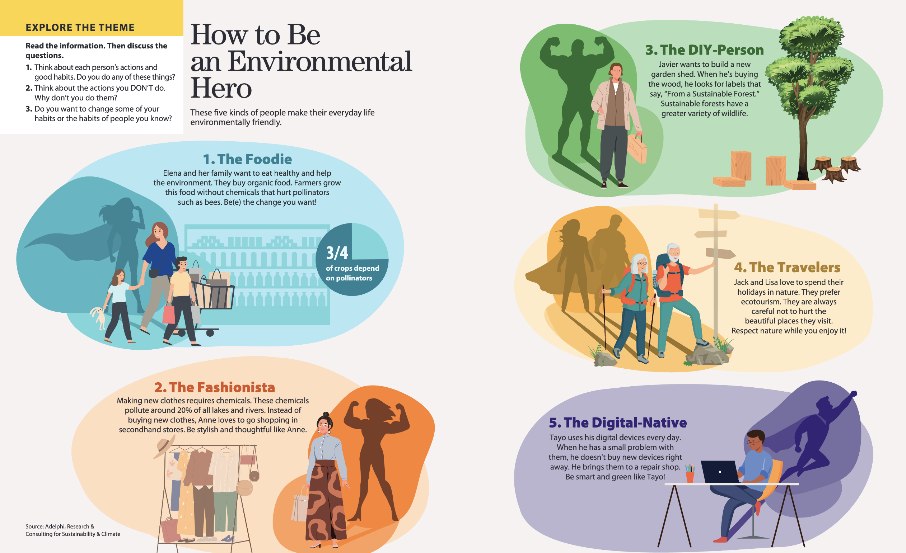

Slide 6

01
Vocabulary A

Slide 7

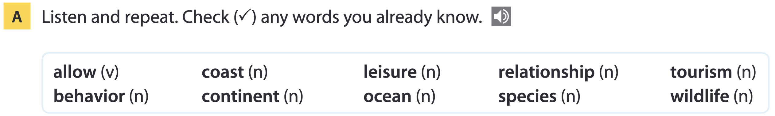
Page 164

Slide 8
Word list
allow /əˈlaʊ/ (v): cho phép
behavior /bɪˈheɪvjər/ (n): hành vi, cách cư xử
coast /kəʊst/ (n): bờ biển
continent /ˈkɒntɪnənt/ (n): lục địa, châu lục
leisure /ˈleʒər/ /ˈliː.ʒɚ/ (n): thời gian rảnh rỗi
ocean /ˈəʊʃən/ (n): đại dương
relationship /rɪˈleɪʃnʃɪp/ (n): mối quan hệ
species /ˈspiːʃiːz/ /ˈspiː.siːz/ (n): loài (sinh vật)
tourism /ˈtʊərɪzəm/ (n): ngành du lịch
wildlife /ˈwaɪldlaɪf/ (n): động vật hoang dã

Slide 9
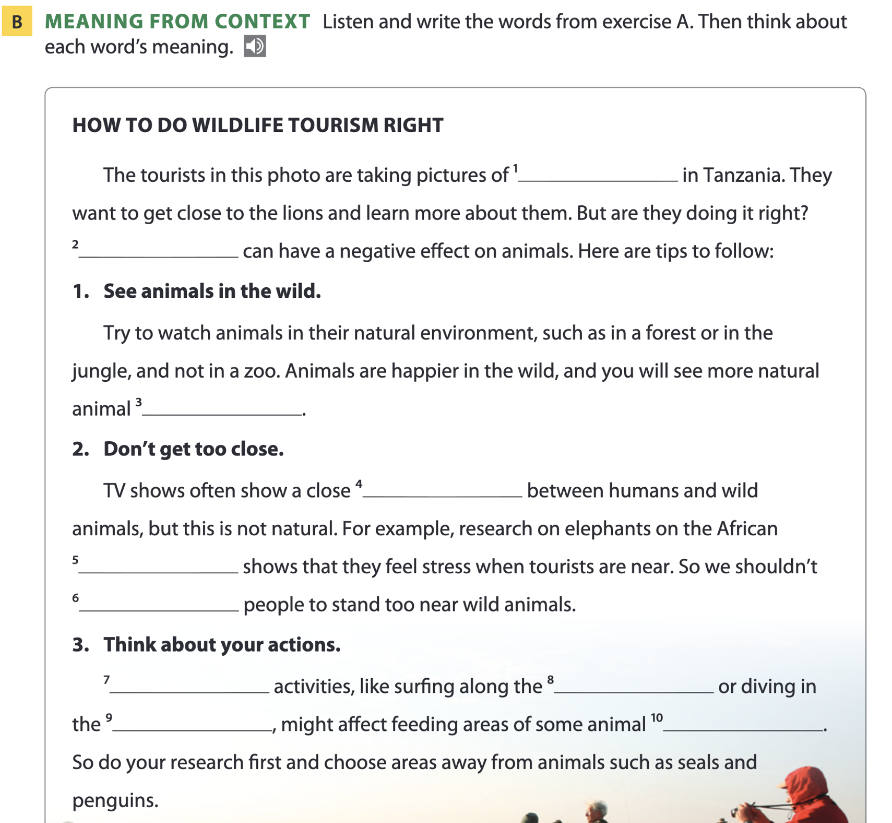
Page 164
wildlife
Tourism
behavior
relationship
continent
allow
Leisure
coast
ocean
species

Slide 10
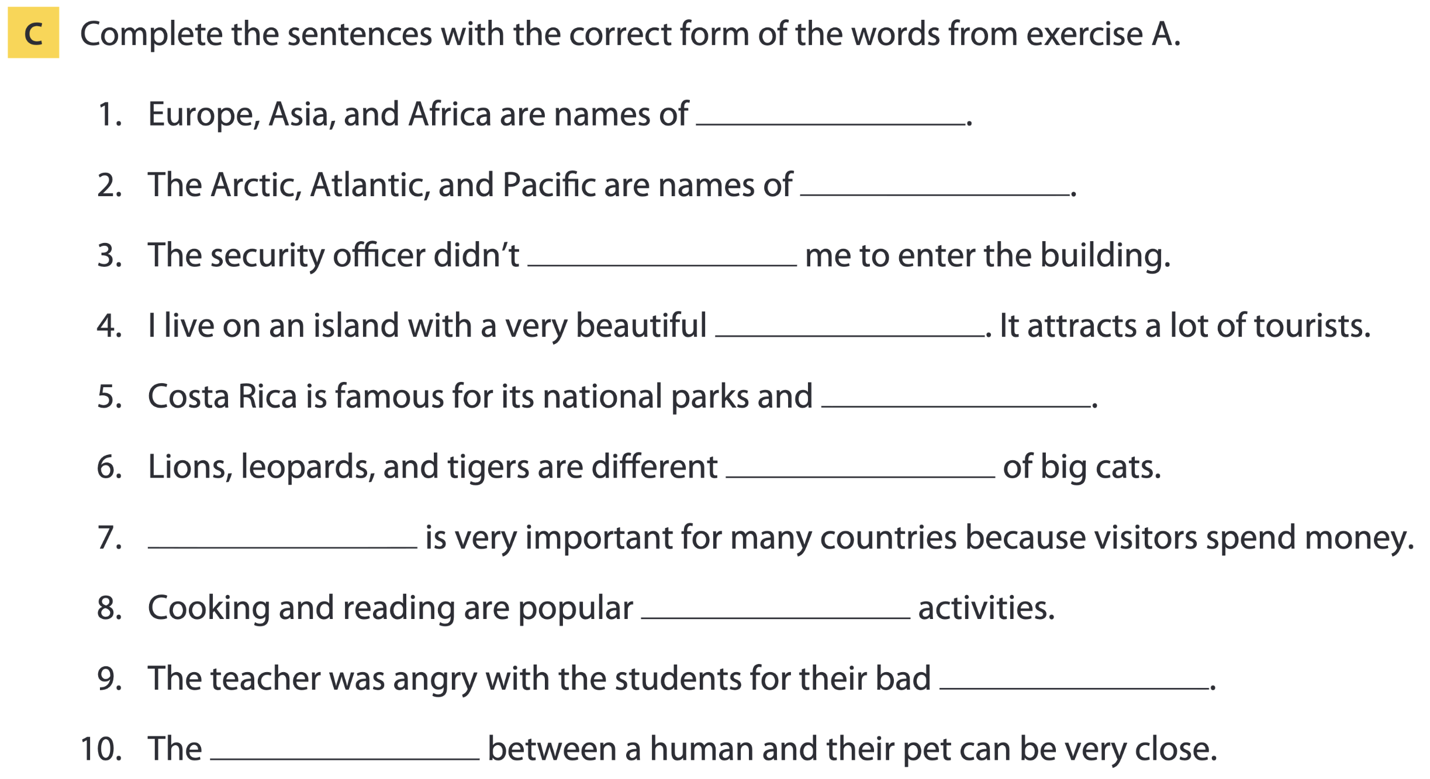
Page 165
continents
oceans
allow
coast
wildlife
species
Tourism
leisure
behavior
relationship

Slide 11
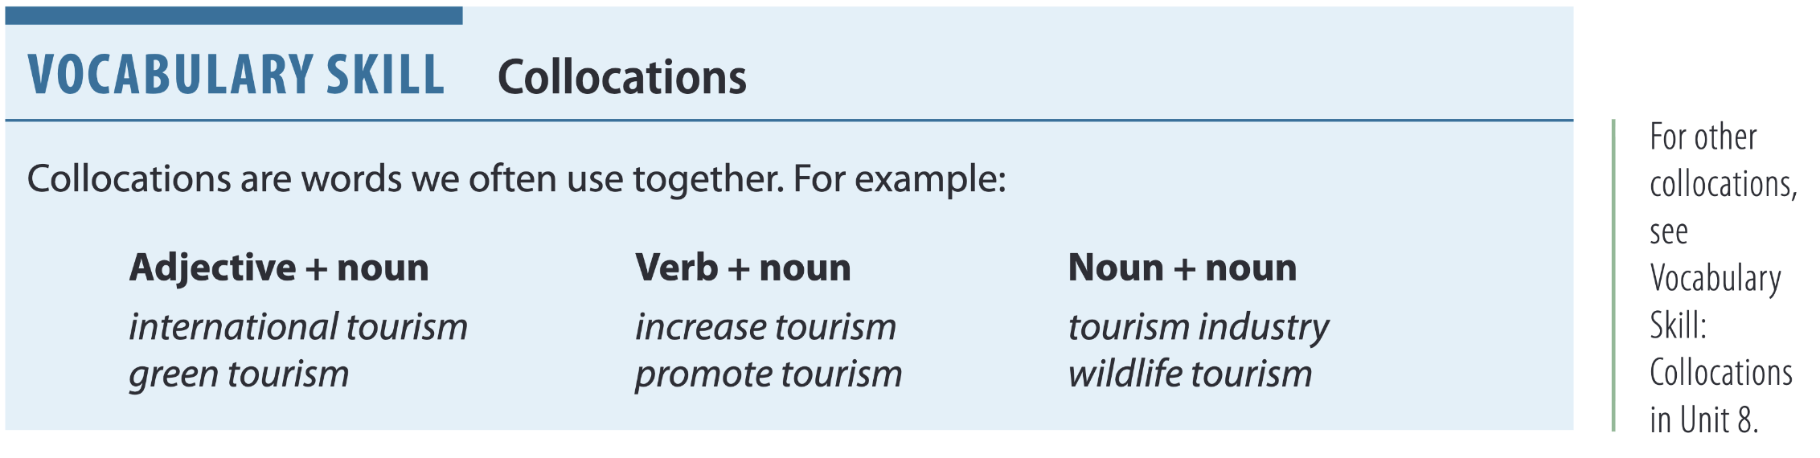
Page 165

Slide 12
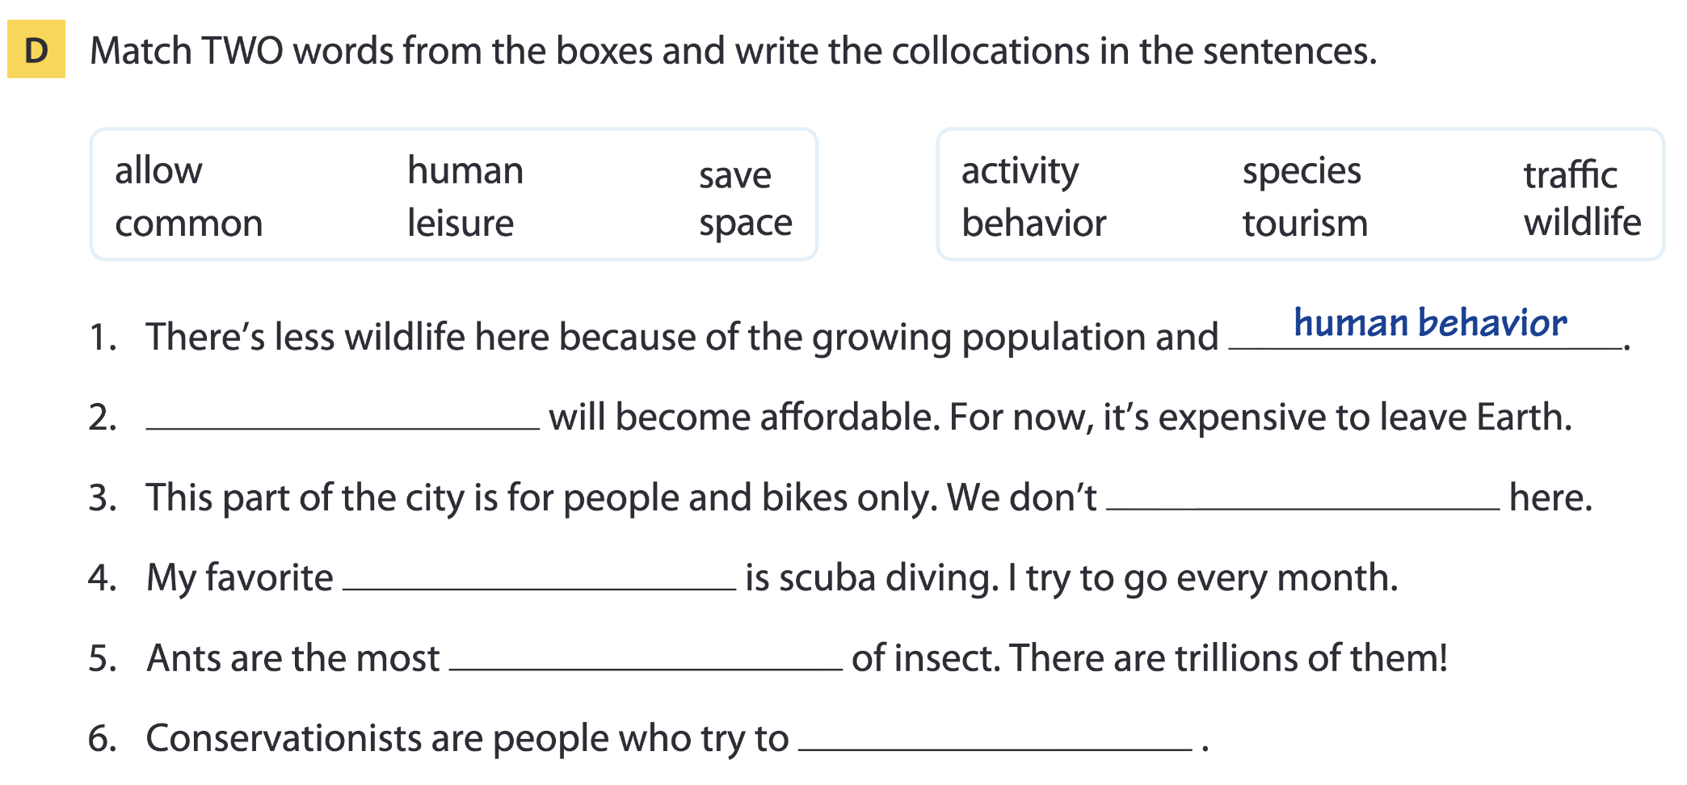
Page 165
Space tourism
allow traffic
leisure activity
common species
save wildlife

Slide 13
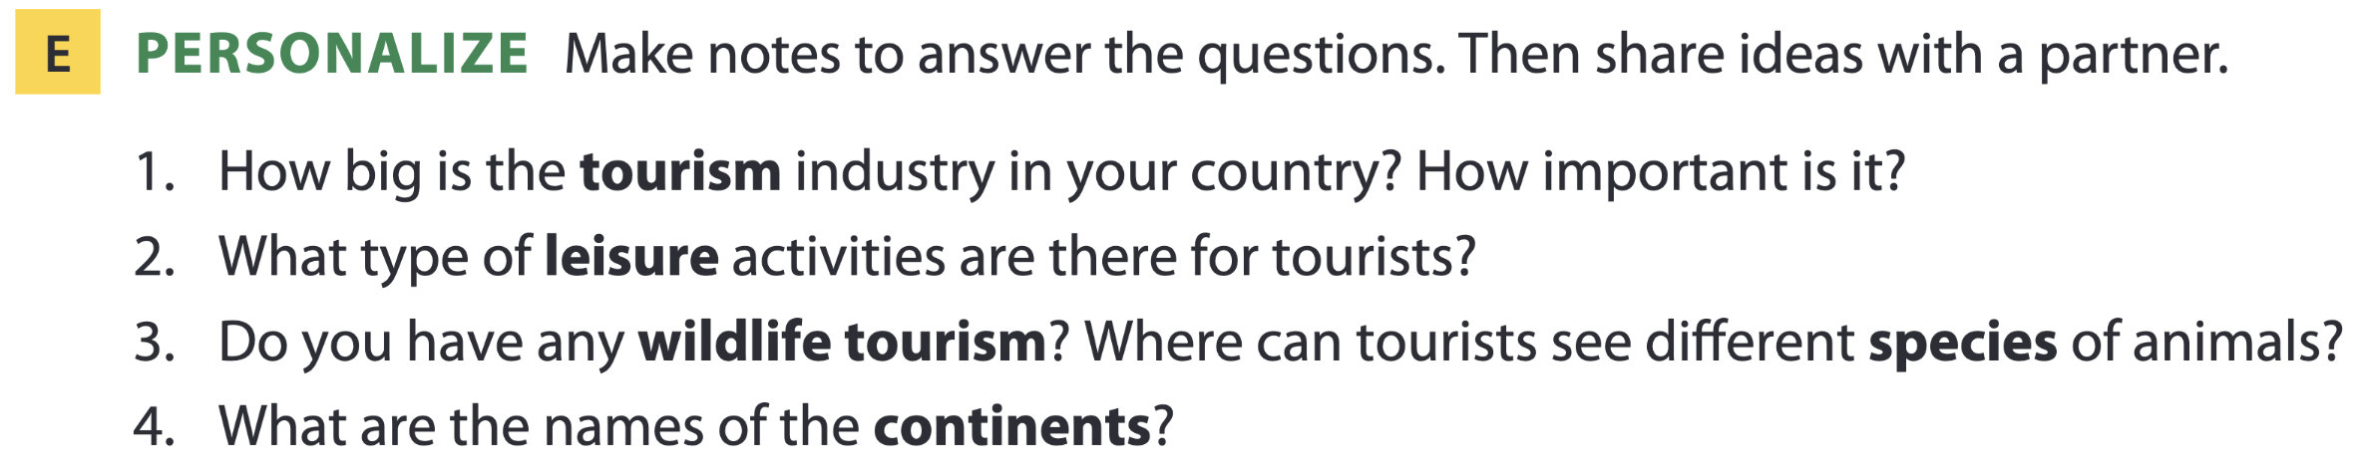
Page 165

Slide 14

02
Listening A

Slide 15
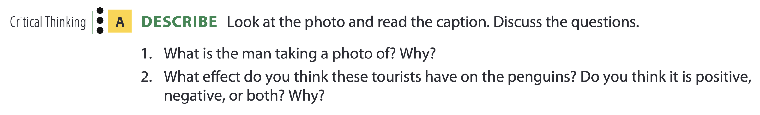
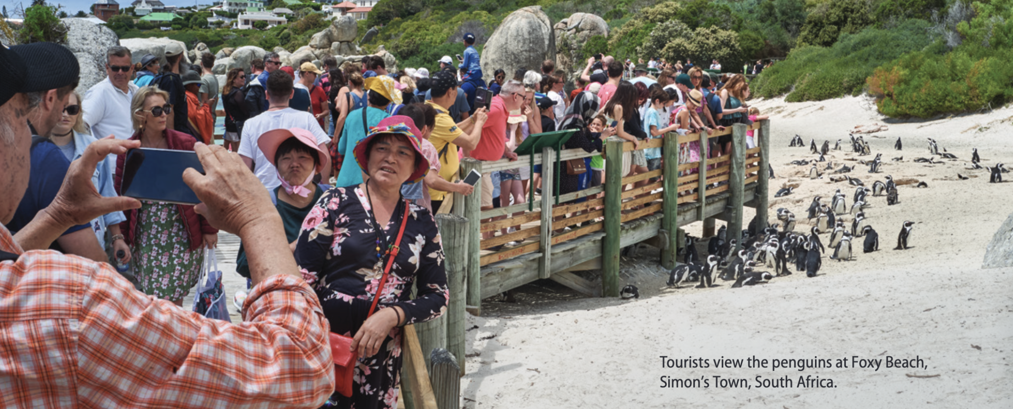
The Penguins at Simon’s Town

Slide 16
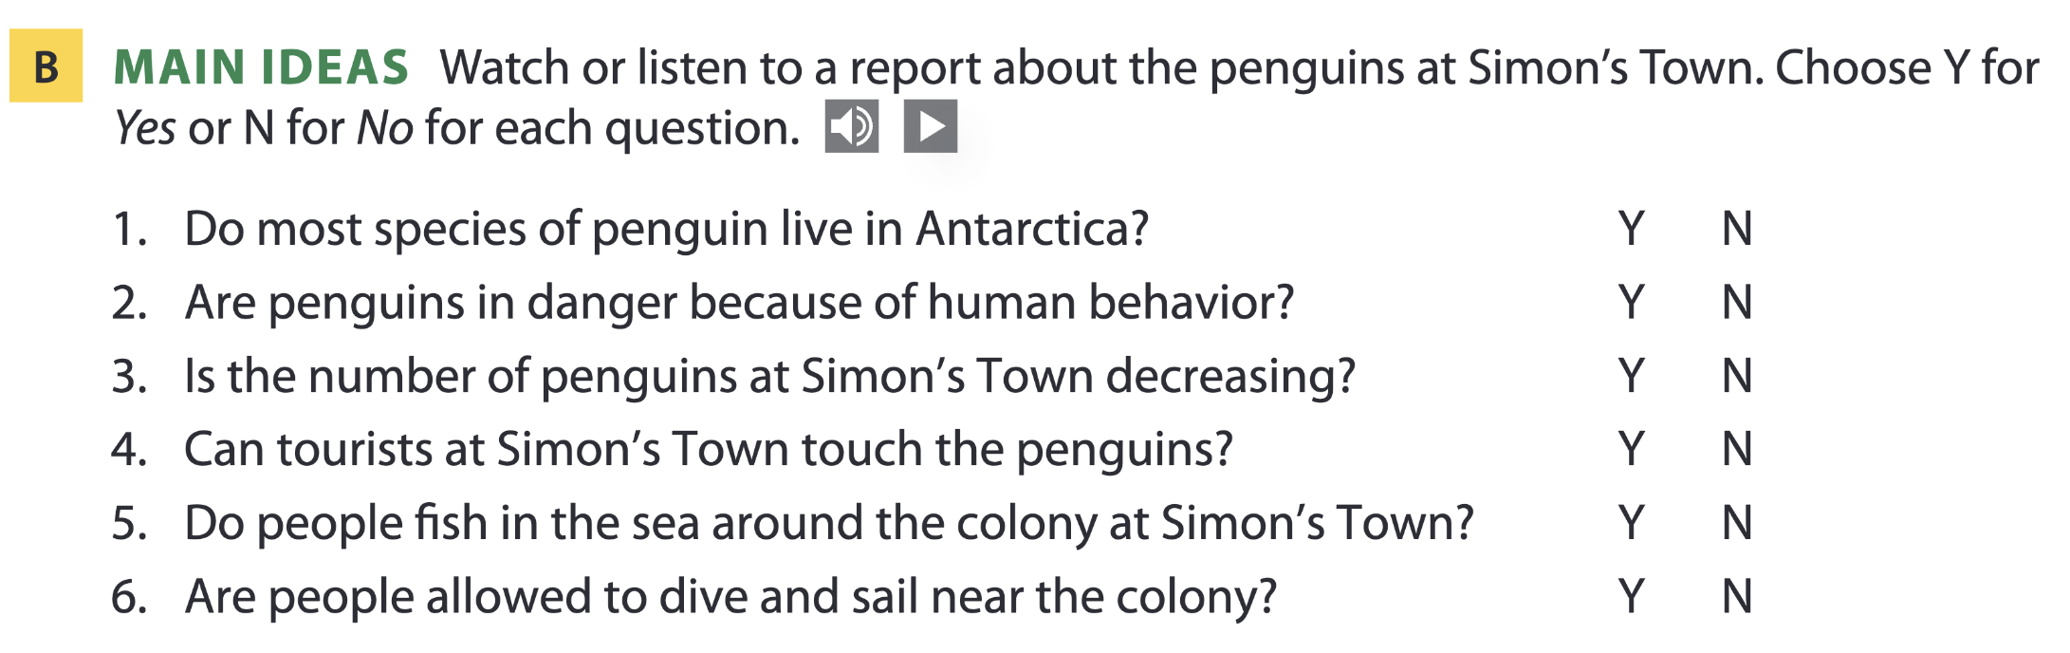
Page 166

Slide 17
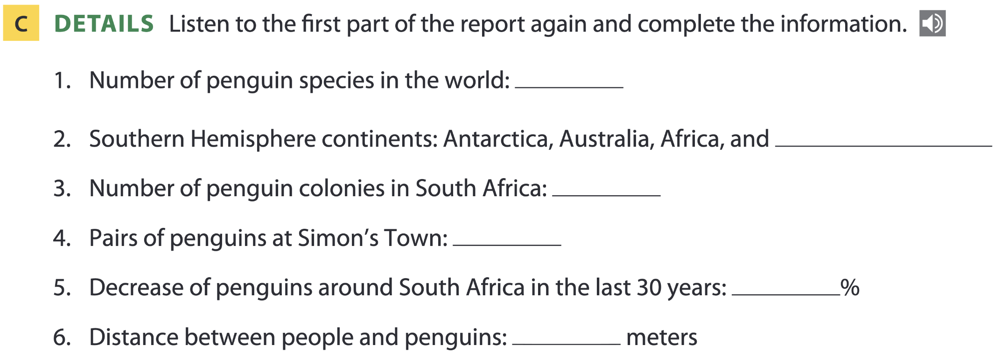
Page 167
18
South America
6
985
73
3

Slide 18
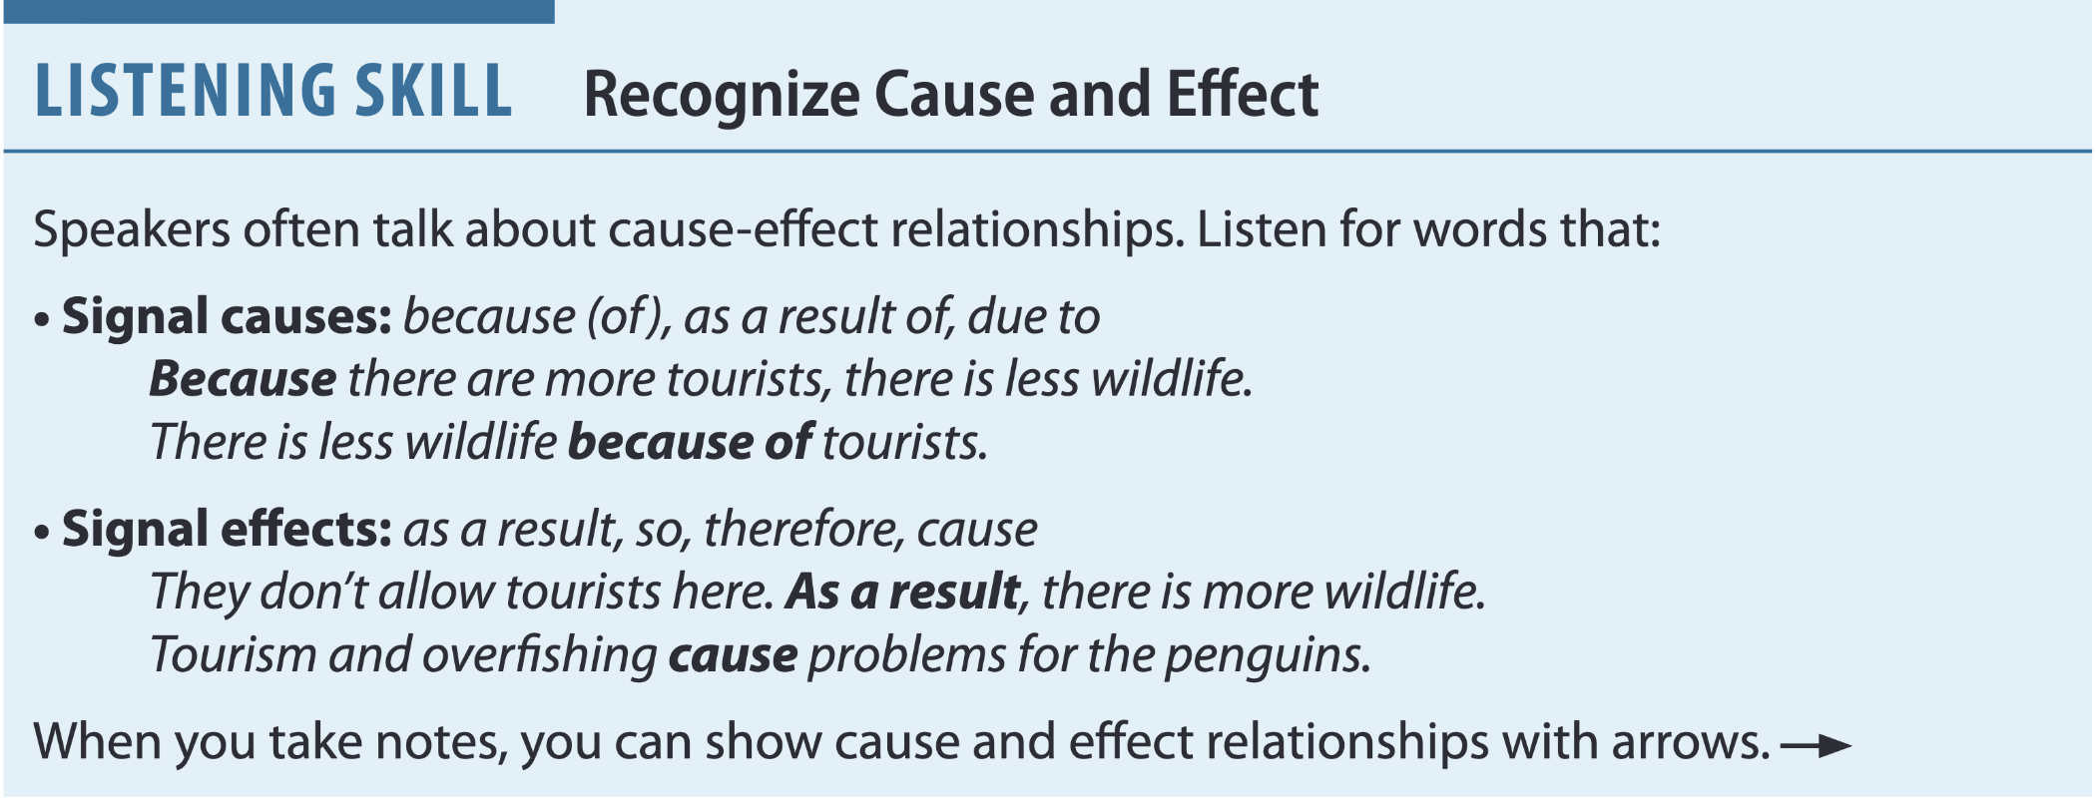

Page 167
more tourists less wildlife
tourists not allowed more wildlife
tourism and overfishing problems for penguins

Slide 19
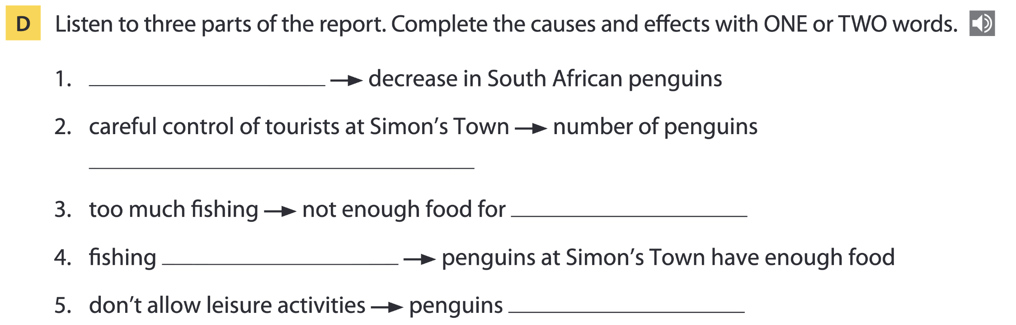
Page 167
tourism
the same / same / doesn’t change
wildlife / penguins
not allowed
are safe / safe

Slide 20
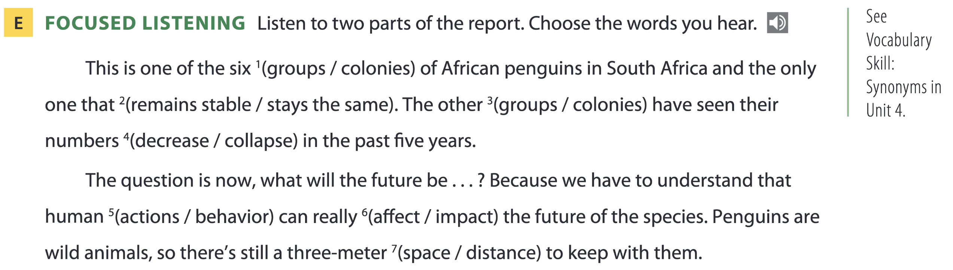
Page 167

Slide 21
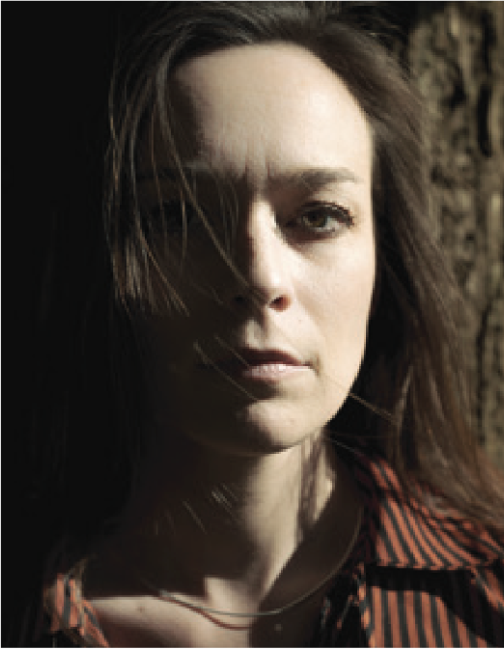
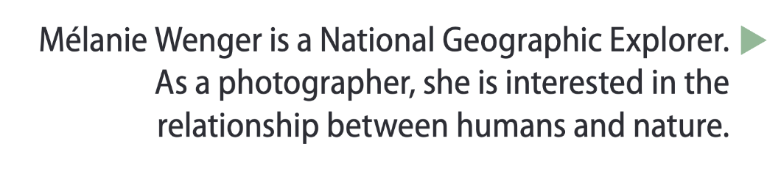
Page 167

Slide 22

03
Video watching

Slide 23
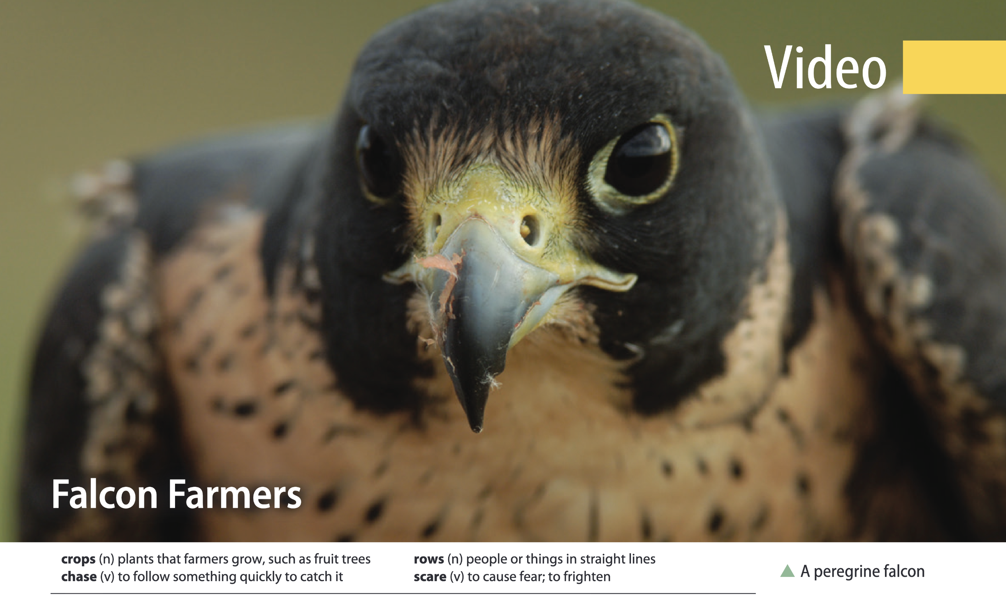
Page 171

Slide 24
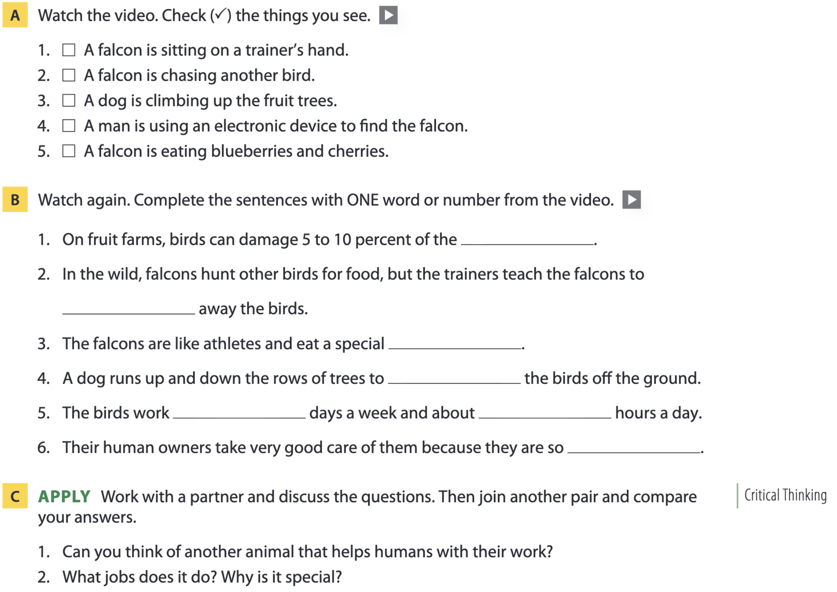

Page 171
crops
chase
diet
scare
7 14
special

Slide 25
04
Vocabulary B

Slide 26
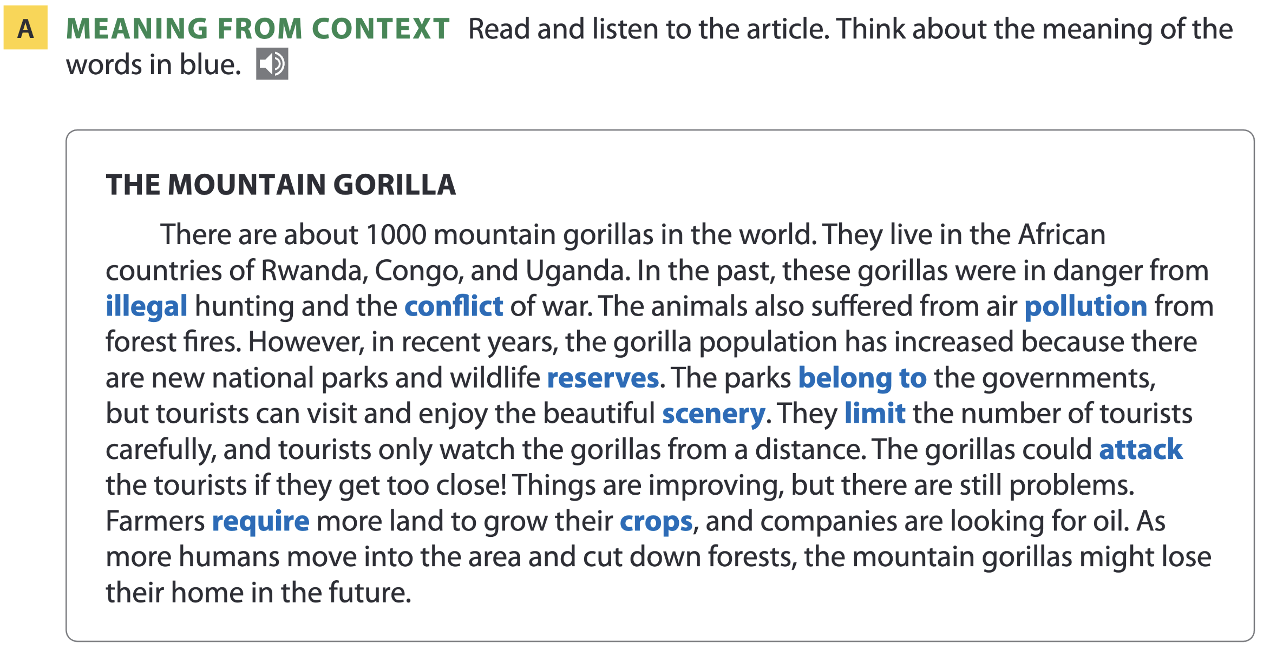
Page 172

Slide 27
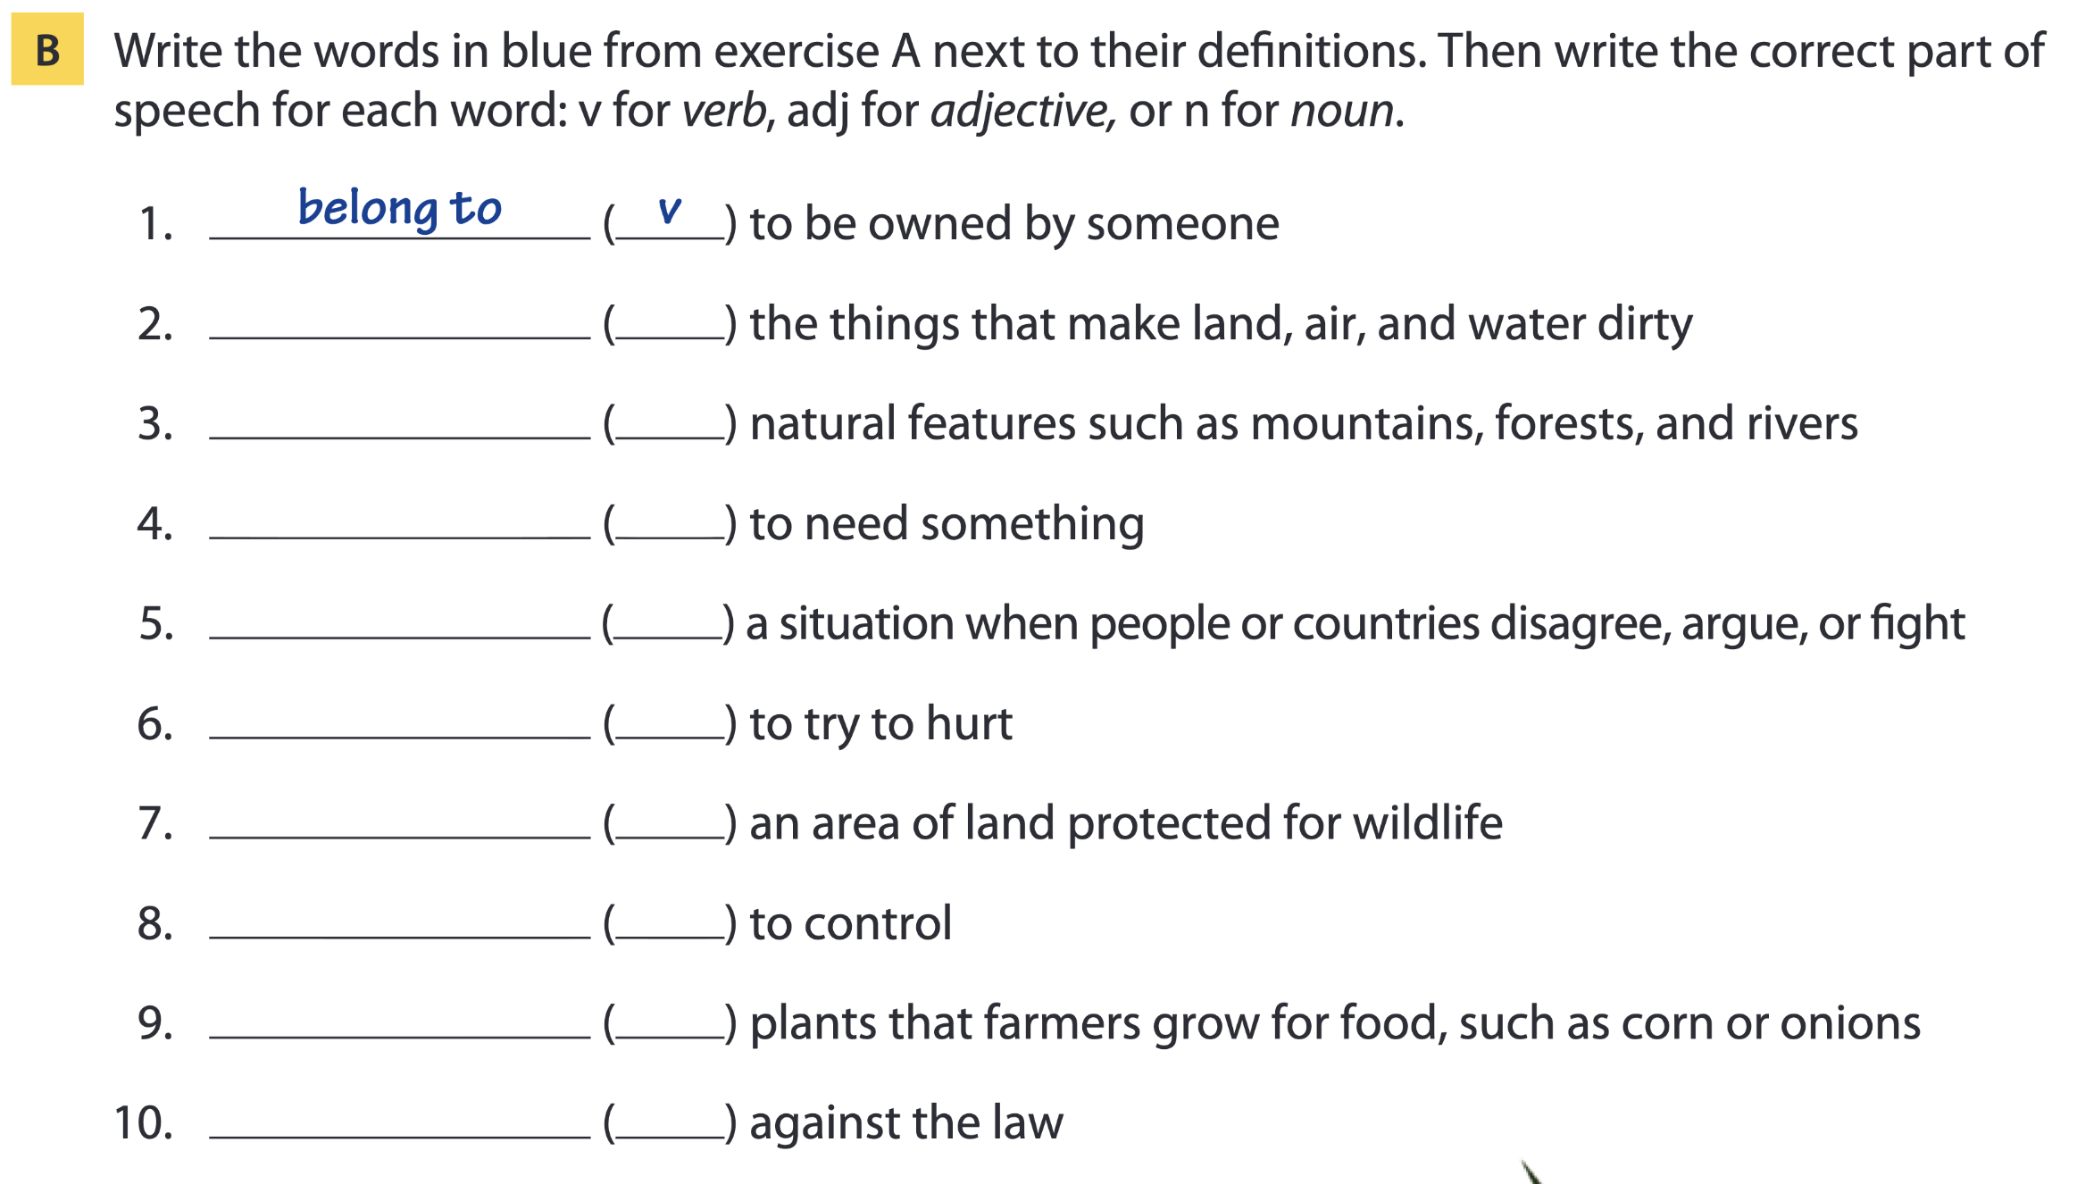
Page 152
pollution n
scenery n
require v
conflict n
attack v
reserve n
limit v
crops n
illegal adj

Slide 28
Word list
belong to /bɪˈlɒŋ tuː/ (v): thuộc về (sở hữu bởi ai đó)
pollution /pəˈluːʃən/ (n): ô nhiễm
scenery /ˈsiːnəri/ (n): phong cảnh, cảnh vật
require /rɪˈkwaɪər/ (v): yêu cầu, cần
conflict /ˈkɒnflɪkt/ (n): xung đột, mâu thuẫn
attack /əˈtæk/ (v): tấn công
reserve /rɪˈzɜːv/ (n): khu bảo tồn
limit /ˈlɪmɪt/ (v): giới hạn, hạn chế
crop /krɒp/ (n): cây trồng, vụ mùa, mùa màng
illegal /ɪˈliːɡəl/ (adj): bất hợp pháp

Slide 29
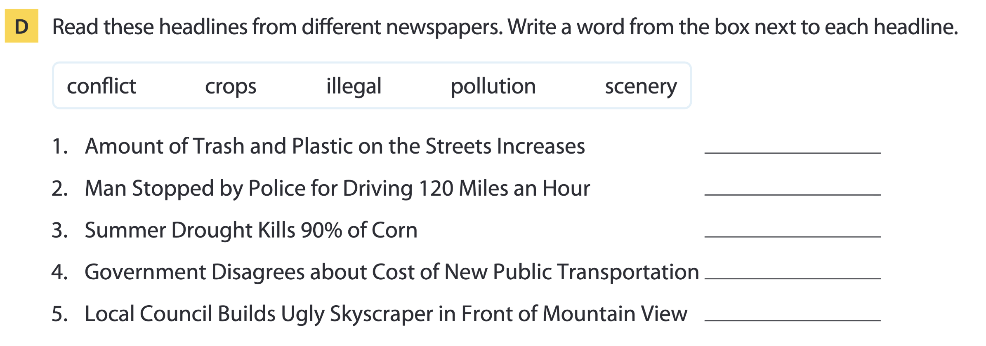
Page 173
pollution
illegal
crops
conflict
scenery

Slide 30
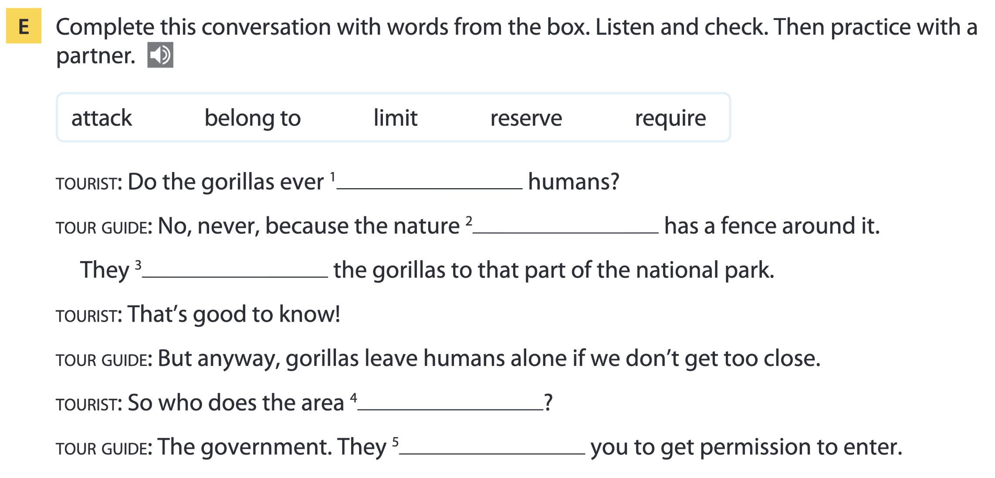
Page 173
attack
reserve
limit
belong to
require

Slide 31
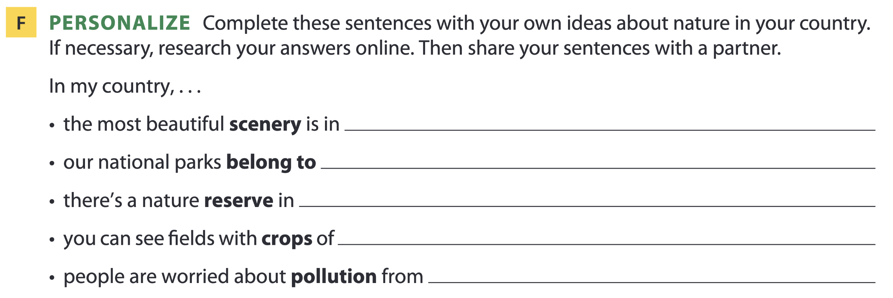
Page 173

Slide 32
05
Listening B

Slide 33
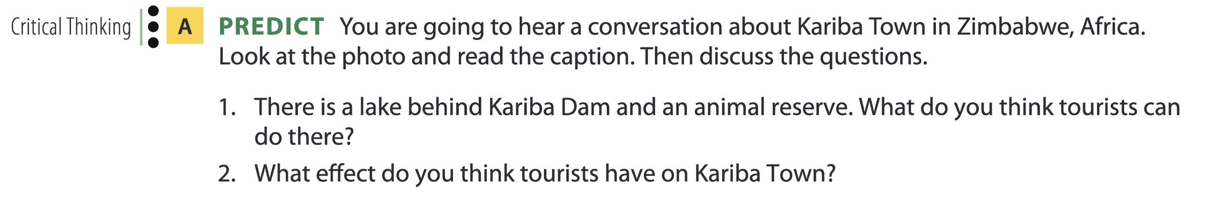
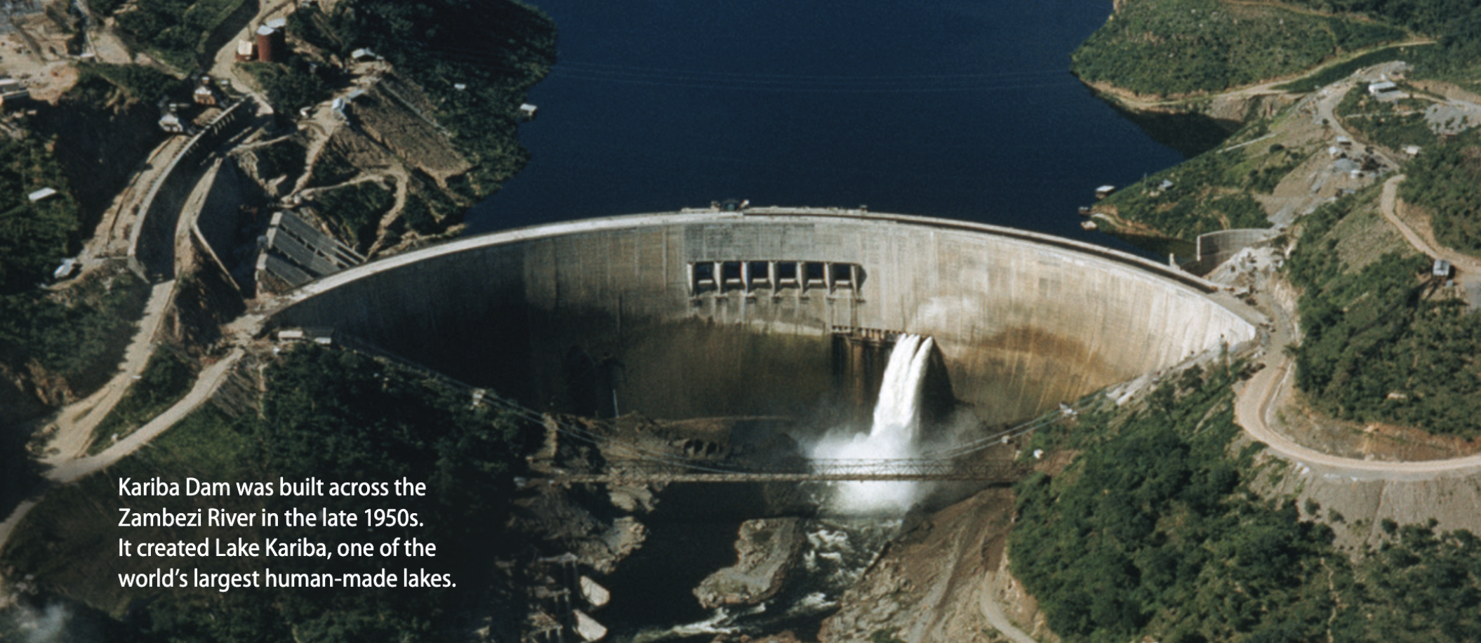
Kariba Town, Zimbabwe

Slide 34
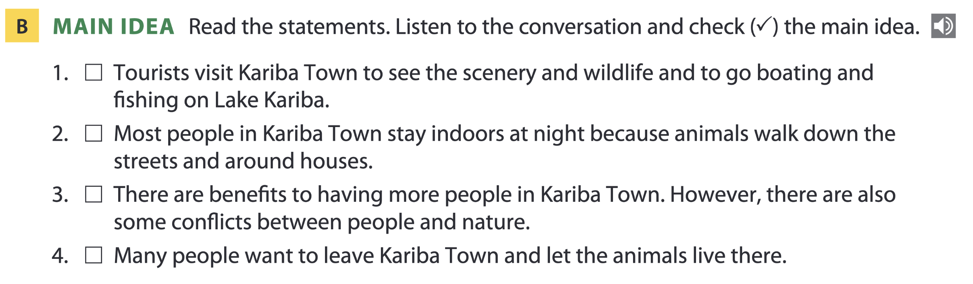
Page 174

Slide 35
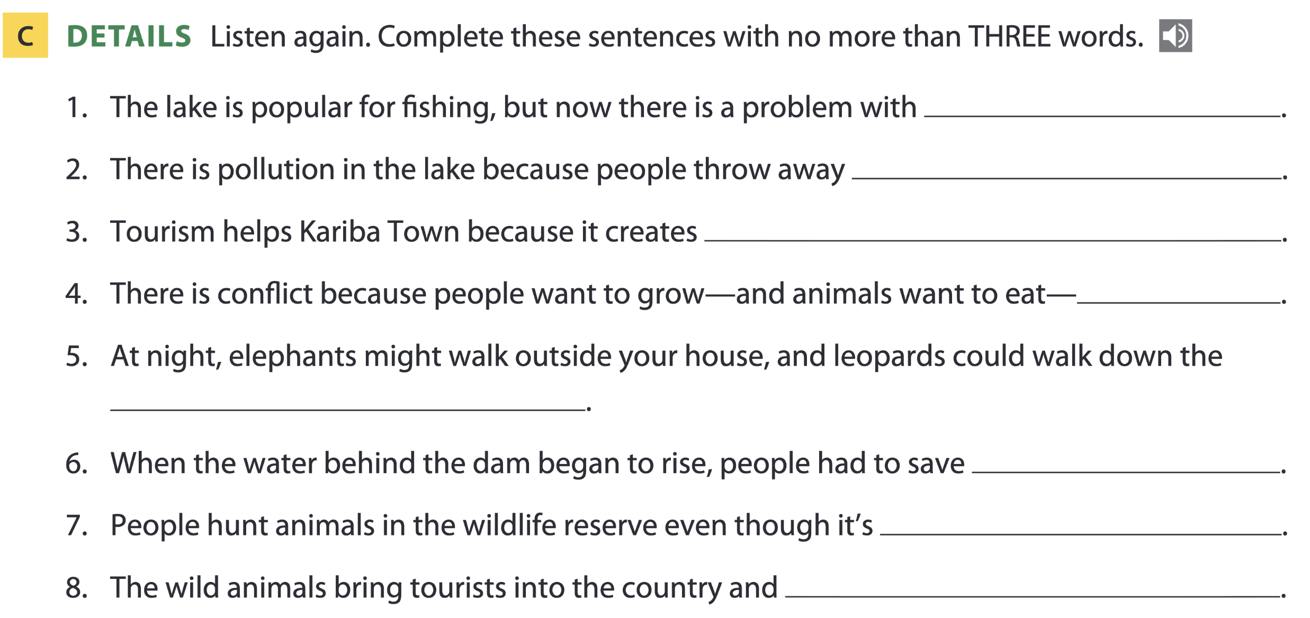
Page 174
overfishing / pollution
their trash / trash
local jobs
crops
main street / street
animals
illegal
money from tourism / money

Slide 36
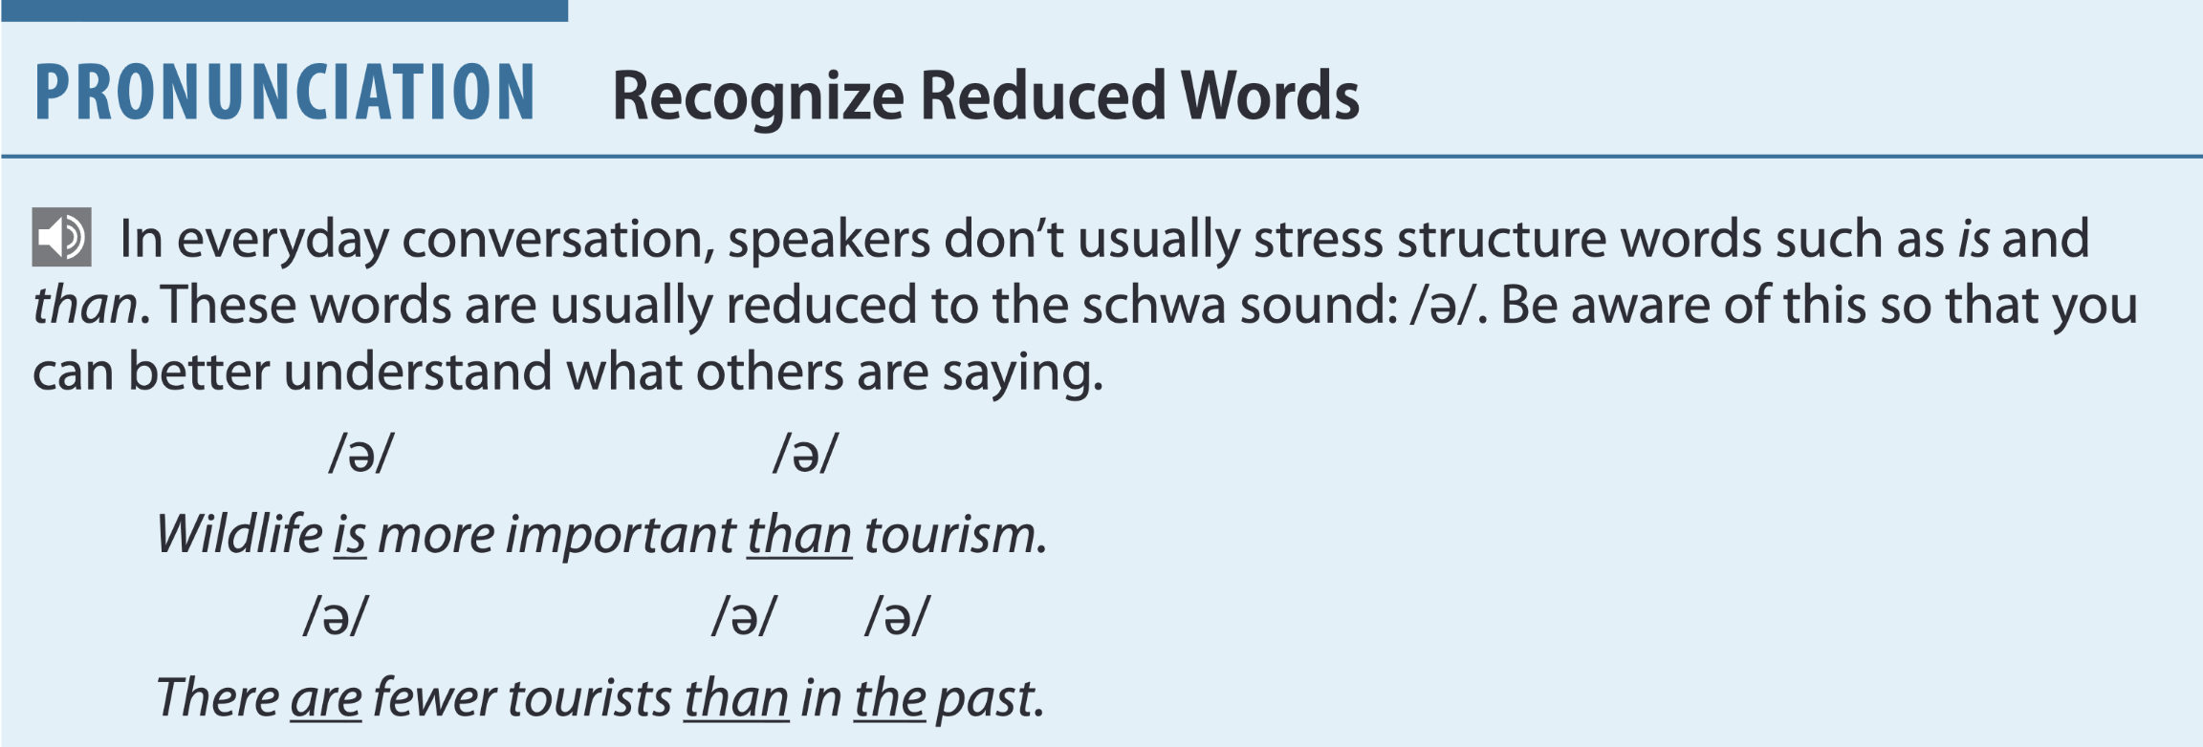

Page 174
Which words are most important for meaning in these sentences?

Slide 37
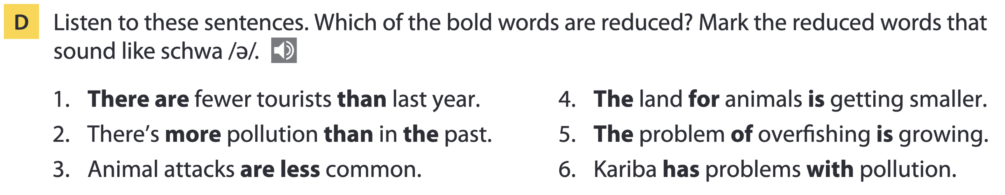
Page 175
Note:
When spoken alone, words like the have more stress.
When spoken in a sentence, these words have reduced stress and usually, but not always, take the schwa sound.

Slide 38
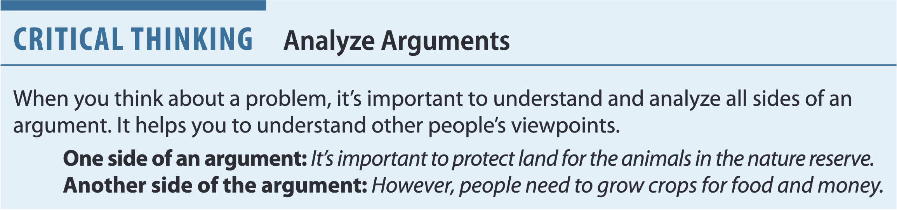
Page 175

Slide 39
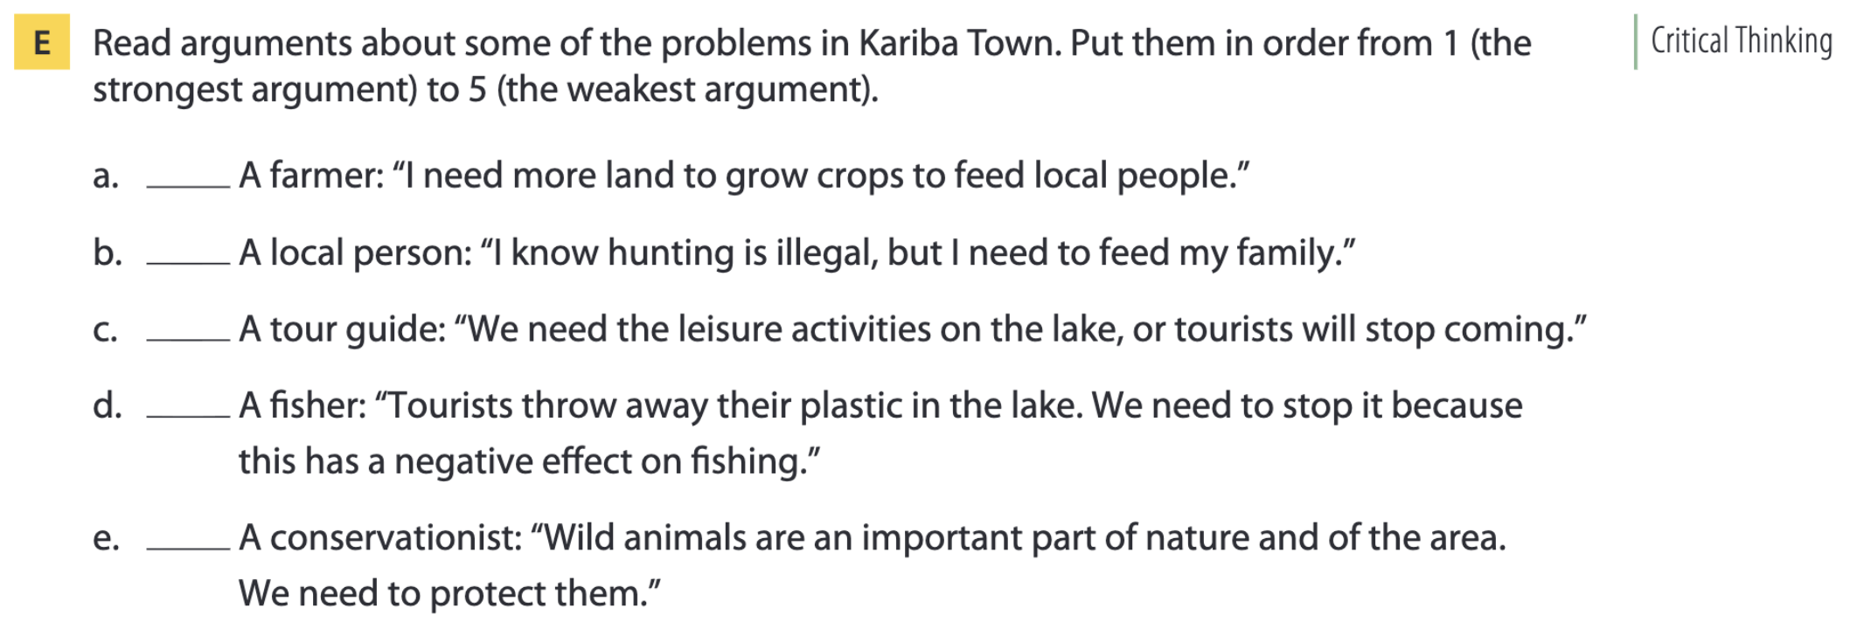
Page 175

Slide 40
THANKS FOR YOUR ATTENTION!

